Slide 1
The Impact of Large Language Model Tutors on Undergraduate Learning
Hannah Brown
Advisor: Narges Norouzi, PhD
Spring 2025

Slide 2
Introduction 📝
Students are tempted with many ways to access answers to homework (Chegg, ChatGPT, Google…)
Help students avoid these shortcuts with trained LLM tutors
Method of properly reacting to the prominence of AI
Previous LLM tutors were created using Retrieval Augmented Generation (RAG), fine-tuning, and prompt engineering
Two notable examples:
Edison, developed at UC Berkeley, being used in Data 100
PingPong, which was used in Fall 2024 STAT 131A.
These chatbots have been shown to be relevant to the course
Will act as a tutor

Slide 3
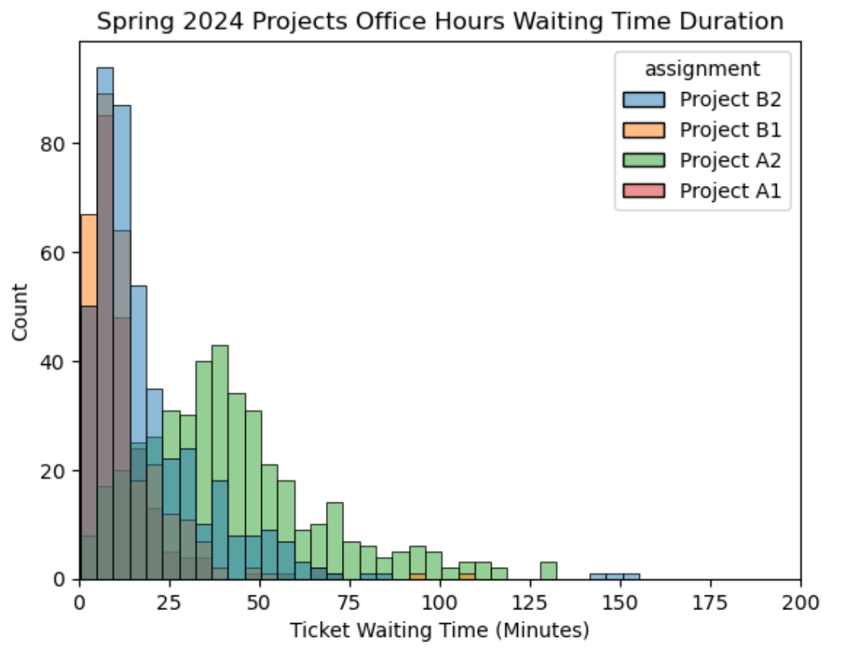
Data Processing ⚙️
Data 100 Office Hours Queue:
Fall 2023 CSV File (Online only), Spring 2024 CSV File (Online + In-person)
Python Libraries: Pandas, Seaborn, Matplotlib
Removed identifiable information, null values, outliers, created a ticket duration column
Prevalence of tickets with extensive waiting times → Need for solutions
Tickets > 50 min

Slide 4
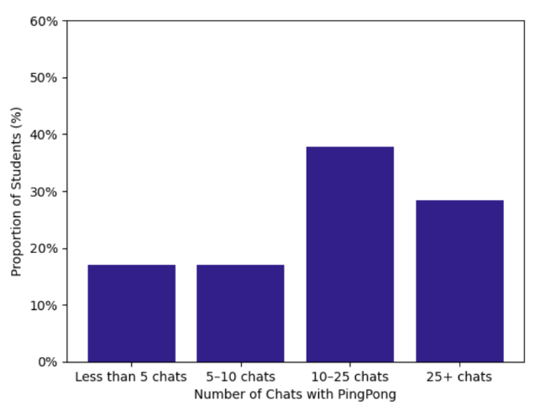
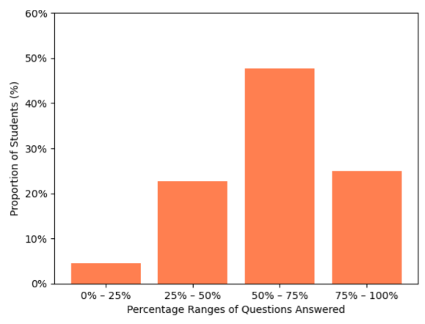
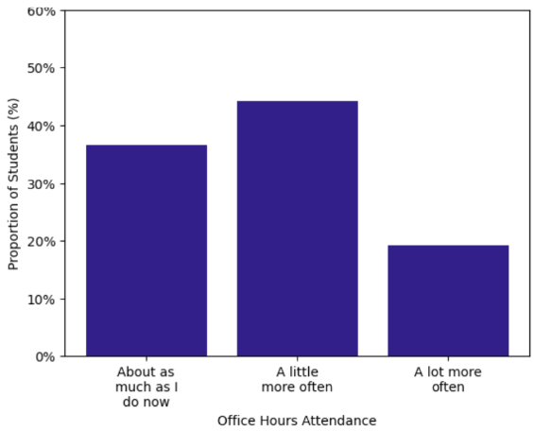
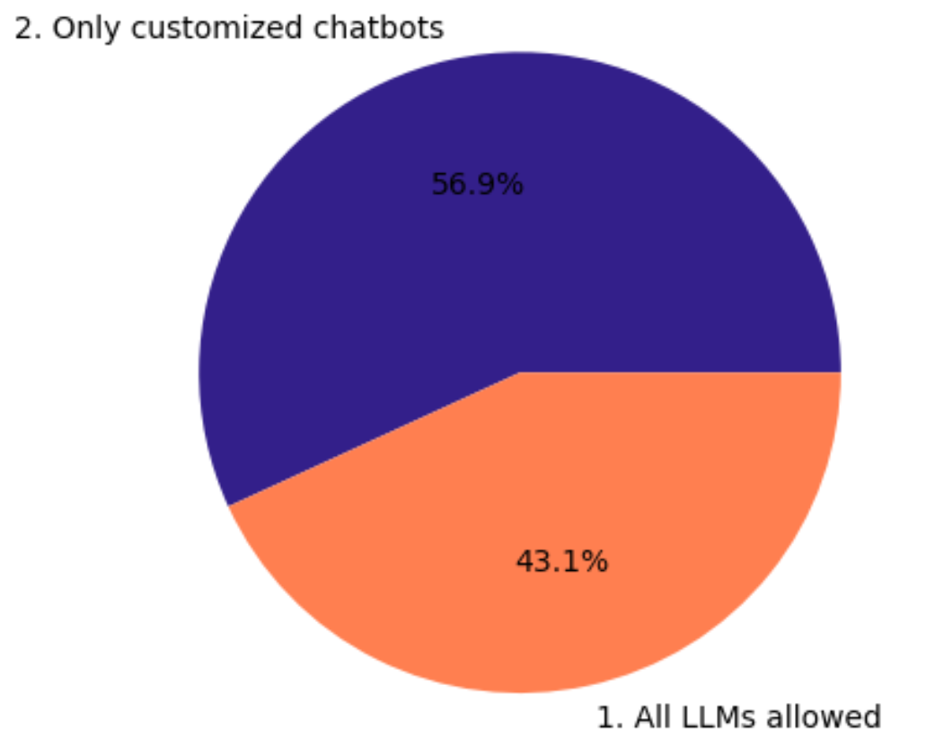
Survey Data 📋
PingPong Usage
% of Questions Answered by PingPong
PingPong Software Survey:
Survey on GPT-4o based LLM tutor
Survey is IRB-approved, anonymous
Received 53 responses out of 88 students
Google Forms -> CSV -> Dataframe
Matplotlib Library for visualizations
Students preferring PingPong over other LLMs
Office Hours Attendance Before LLMs
Opinion of LLMs in Future Courses

Slide 5
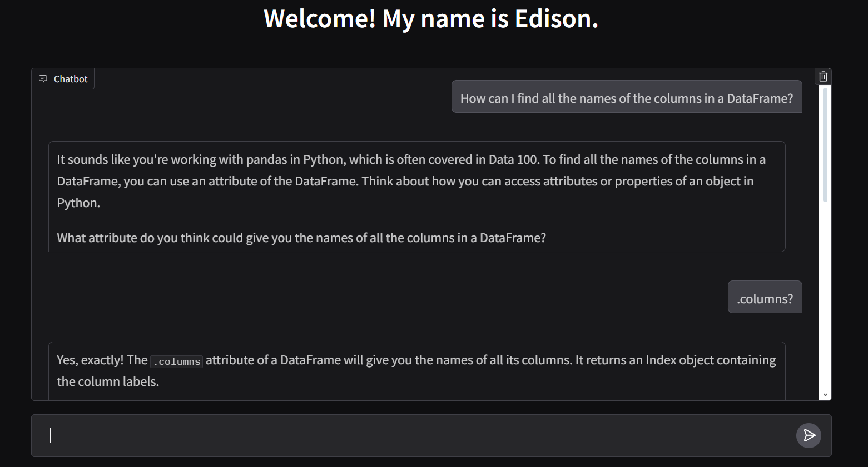
Edison GUI Development 💻
Knows the course to provide information for
After learning about PingPong, created solution to help office hours queue
Built off Edison team’s backend
LLM trained on course material and TA interaction
Gradio Python Library
GUI allows for direct interaction to the LLM
TA’s think it is better for conceptual questions
Asks Students for their thoughts
Simple Interface
Encouraging tone + Provide more context
Brief Outputs + References original question
Text Formatting

Slide 6
Conclusion + Next Steps🧭
AI tutors bring both challenges and benefits
Concerning regarding impact on human tutoring, problem-solving, and data privacy
AI tutors increase student access to support
Tools like Edison + PingPong are valuable supplements
Next Steps:
Edison + PingPong will be expanded to more courses
Higher accuracy, Allow for document upload, Saved conversations
Thank you!

